Slide 1

Presentation
Introductions – Brett Keenan
Project Vision – Michael Emard
Use Cases – Jeff Hicks
Database – Levi Smith
User Interface – Michael Emard
Testing – Eric Kramber
Estimated/Actual Hours – Tamrah Snyder
Future Plans – Tamrah Snyder
Summary/Q&As – Brett Keenan

Slide 2
Introductions
RWL Members
Brett Keenan
Manager
Tamrah Snyder
Michael Emard
Documenter
Architect
Jeff Hicks
Eric Kramber
Systems
Levi Smith
Tester
Developer
Lockheed Clients
David Morgan, Scott Hoyle, Shane Mueller
http://www.lockheedmartin.com
Project Advisor
David Smith

Slide 3
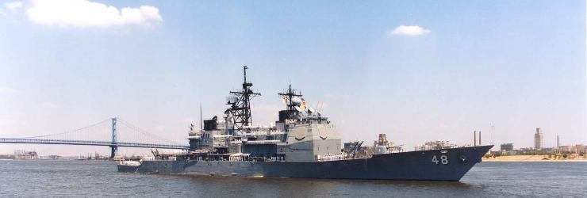
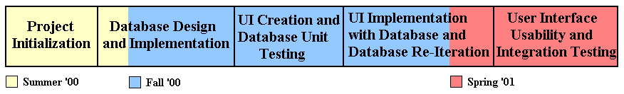
Project Vision
Project Description
Short and Long Term Goals

Slide 4
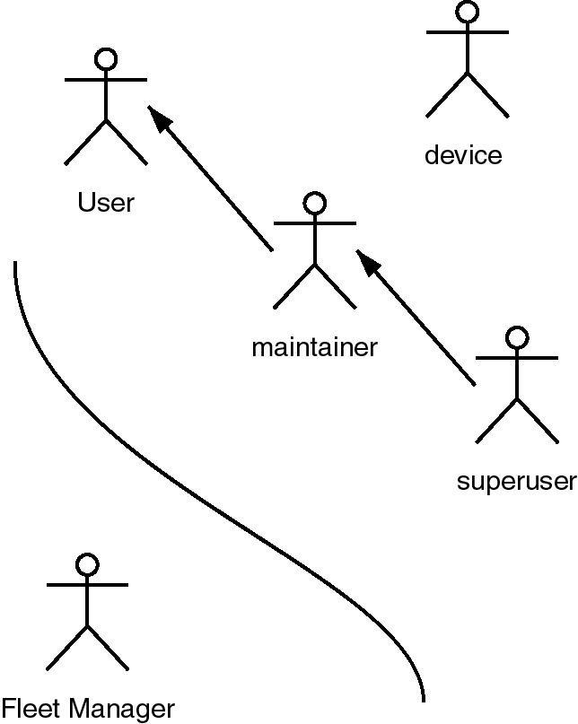
Use Cases
User
query devices
Maintainer
install devices
Super User
manage users
Device
record status

Slide 5
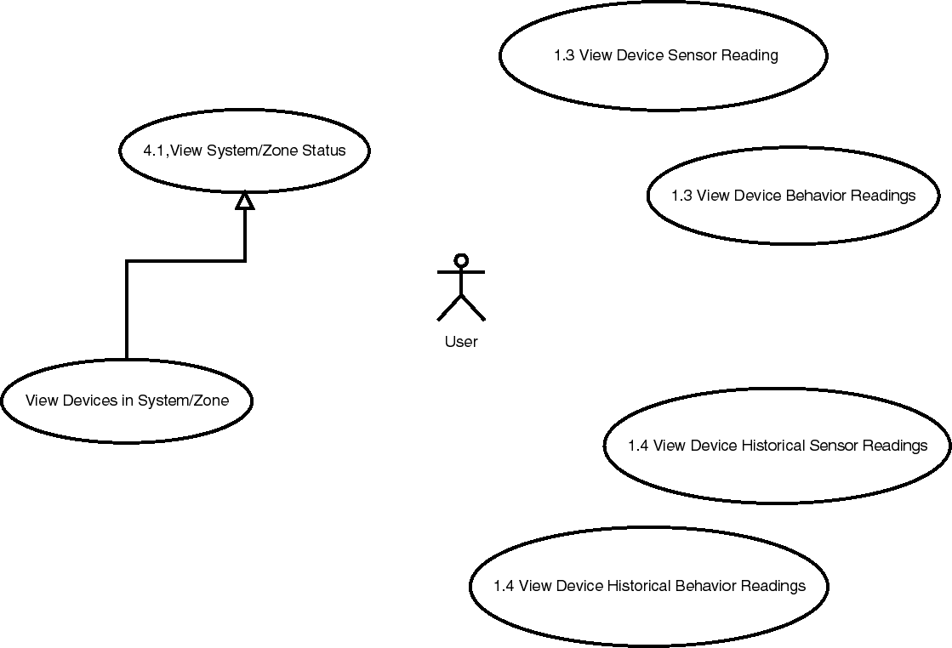

Slide 6
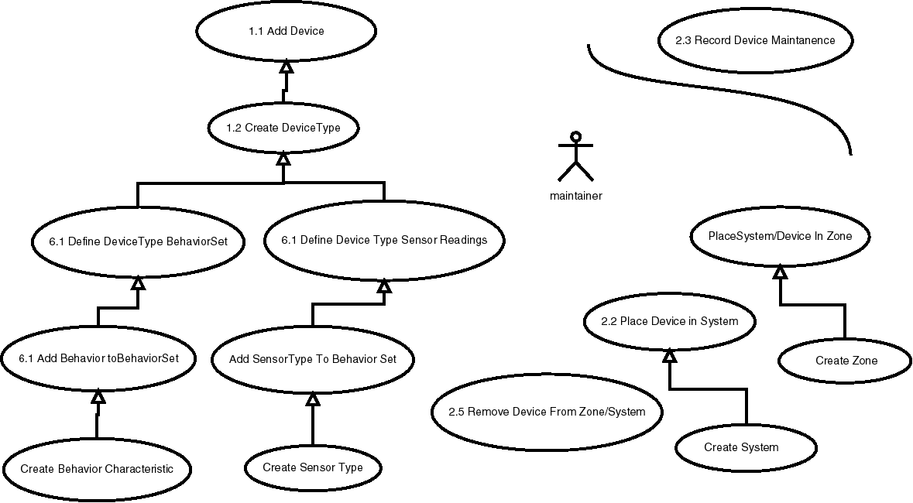

Slide 7
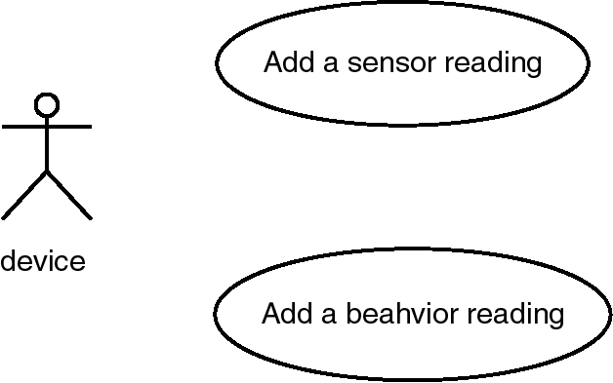
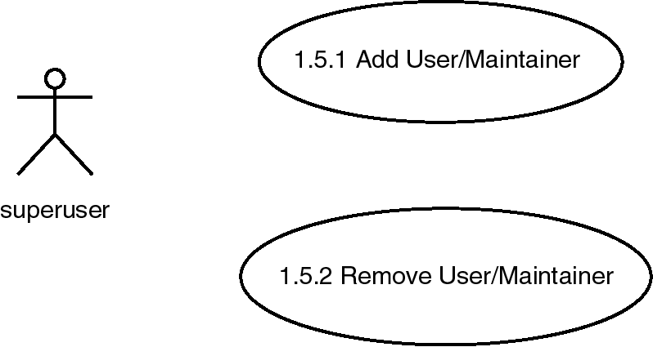

Slide 8
Database Design
Database Flexibility
Satisfaction of Requirements
Separation of Behavior Characteristics
Connectivity Between Tables

Slide 9
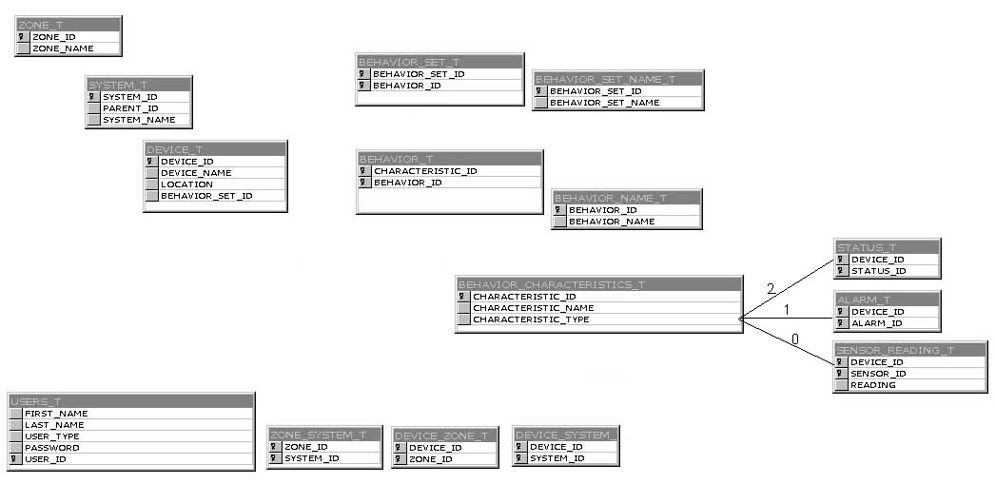
Database Design

Slide 10
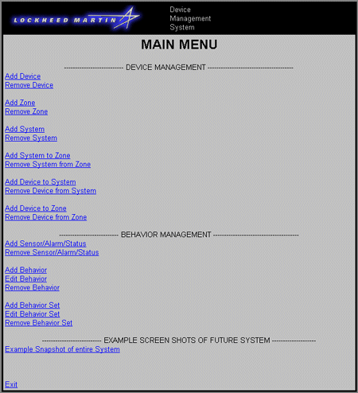
User Interface

Slide 11
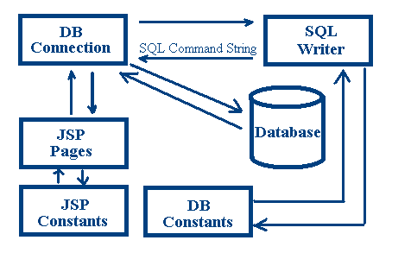
UI
Continued…

Slide 12
Testing
Testing Strategy
  Alpha testing on Rootnode testing environment
  Beta testing with prototype front-end
Testing Problems
  Many database changes caused coding time to run-over
Future Testing Plans
  Test SQL code on Rootnode
  Implement tested “bug-free” code into back-end
  Test new front-end and back-end together

Slide 13
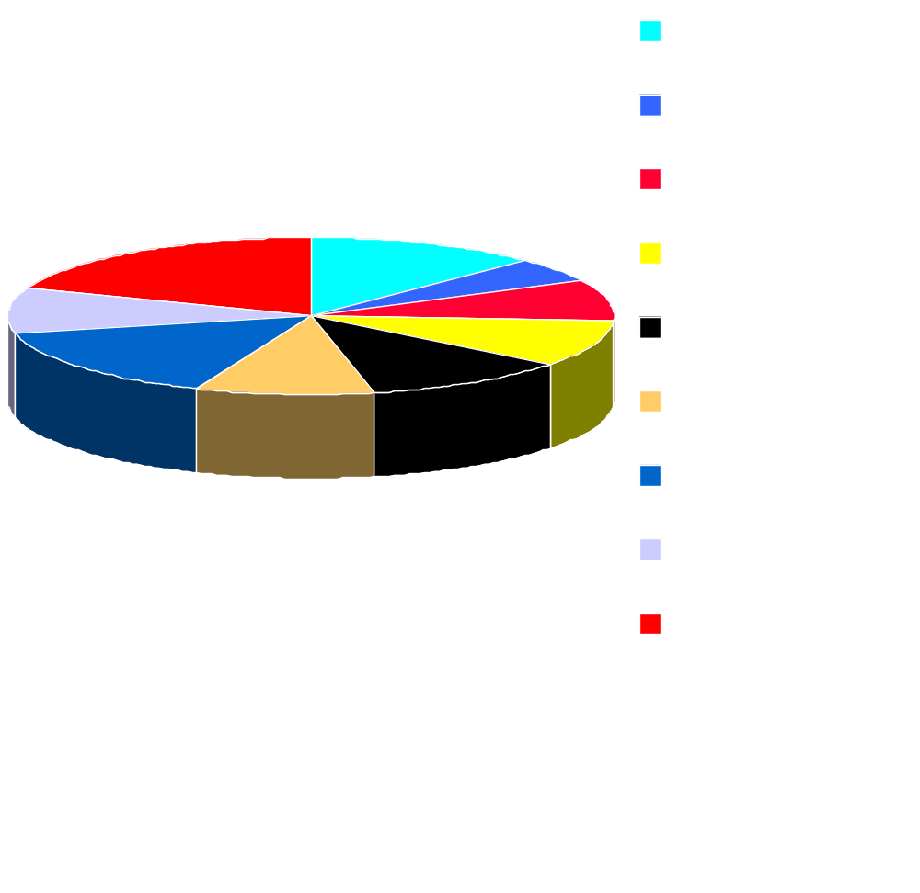
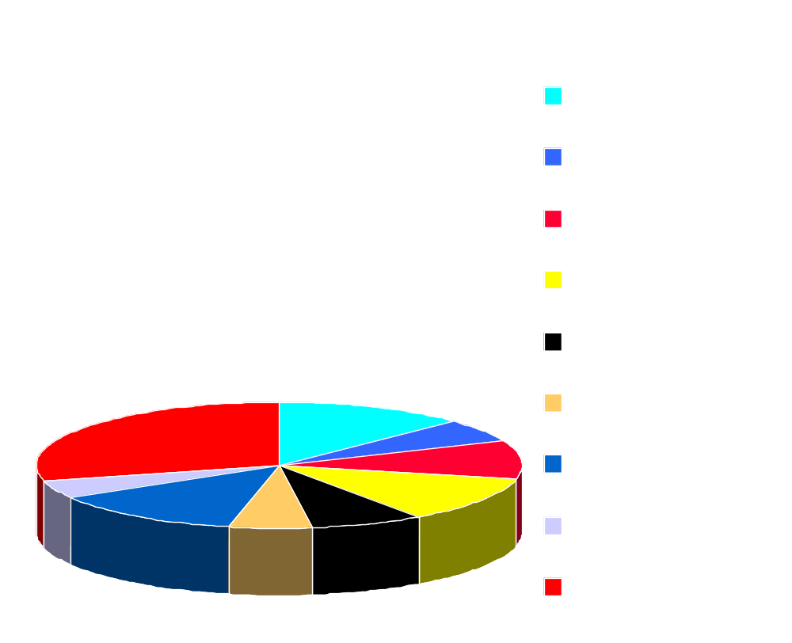
Estimated vs Actual Hours
Estimated
Total: 477
Actual
Total: 552

Slide 14
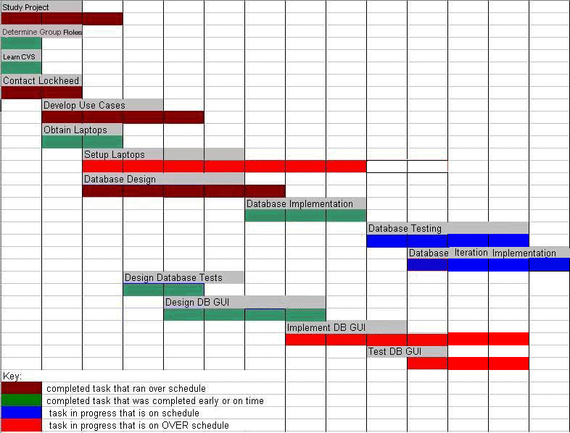
Estimated vs Actual Hours Continued …

Slide 15

Future Plans
Test User Interface
Possible Re-Iteration of Database
Test Entire System
Interface to Actual Devices
Create and Implement User
Interface Additions
Create UI Flow Charts
Create UI Help Files
Turn System Over to Lockheed

Slide 16
Summary
Accomplishments
Lessons Learned
Database Design and Implementation
Completed Simple UI
Setup on Laptops
Documentation Crucial for High Turnover Rate Projects
Set Goals, Not Hours for Tasks
Communication is a Critical & Ongoing Task
RWL Impact
Meaning of Teamwork

Slide 17
Questions & Answers

